Slide 1
SQL Concepts and Queries
RISHI KIRAN

Slide 2
SQL Tables Creation
Create table dept (
dept_id int,
dept_name varchar(20),
primary key (dept_id)
);
Create table employee (
emp_id int,
first_name varchar(20),
last_name varchar(20),
dept_id int,
primary key(emp_id),
foreign key(dept_id) references dept(dept_id)
);

Slide 3
SQL Data Insertion
INSERT INTO dept VALUES
(10,'HR'),
(20,'Sales'),
(30,'IT'),
(40,'Marketing');
INSERT INTO employee VALUES
(1,'jhon','doe',10),
(2,'jane','smith',20),
(3,'mike','jhonson',30),
(4,'emily','davis',10);

Slide 4
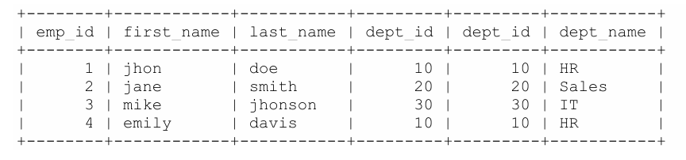
SQL INNER JOIN Example
SELECT * FROM employee
INNER JOIN dept ON employee.dept_id = dept.dept_id;

Slide 5
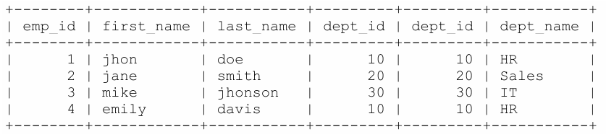
SQL LEFT OUTER JOIN Example
SELECT * FROM employee
LEFT OUTER JOIN dept ON employee.dept_id = dept.dept_id;

Slide 6
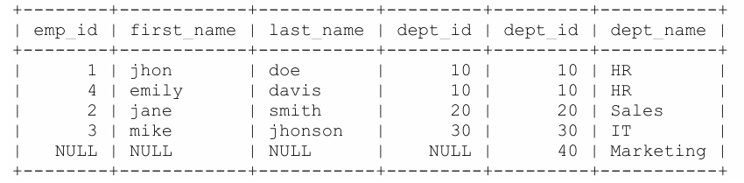
SQL RIGHT OUTER JOIN Example
SELECT * FROM employee
RIGHT OUTER JOIN dept ON employee.dept_id = dept.dept_id;

Slide 7
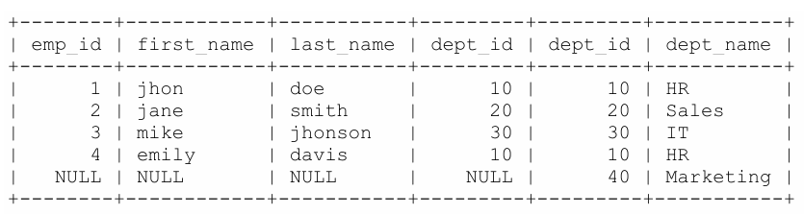
SQL FULL OUTER JOIN Example
SELECT * FROM employee
FULL OUTER JOIN dept ON employee.dept_id = dept.dept_id;

Slide 8
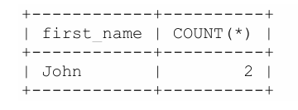
Find Duplicate records Based on firstName
SELECT first_name, COUNT(*) FROM Employee GROUP BY first_name HAVING COUNT(*) > 1;

Slide 9
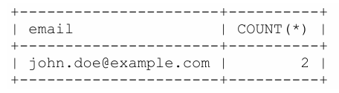
Find Duplicate records based on email
SELECT email, COUNT(*) FROM Employee GROUP BY email HAVING COUNT(*) > 1;

Slide 10
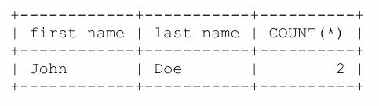
Find Duplicate records Based on firstname and Last Name
SELECT first_name, last_name, COUNT(*) FROM Employee GROUP BY first_name, last_name HAVING COUNT(*) > 1;

Slide 11
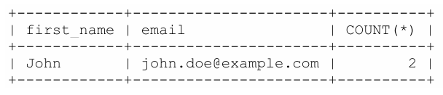
Find Duplicate records Based on firstname and email
SELECT first_name, email, COUNT(*) FROM Employee GROUP BY first_name, email HAVING COUNT(*) > 1;

